Slide 1
Epidemiologic Concepts for ID Modeling
Session 1b Dr. Kristin Nelson

Slide 2
Measures of natural history
Incubation period
Time from exposure to the onset of clinical symptoms
Latent period
Time from exposure to start of infectiousness
Infectious period
Time during which an infected person can transmit to a susceptible host
The reproduction number, R, and herd immunity threshold

Slide 3
Incubation period
Exposure/
Infection
Symptom
onset
Incubation period
0
Time

Slide 4
Incubation period: Why is it important?
Need to measure
Time of exposure/infection (hard)
Time of onset of clinical symptoms (easier)
Can be affected by
Infectious dose
Route of infection
Pathogen replication
Host immune function
Notes:
Onset of symptoms is usually clear
Time of exposure/infection is very hard to know
Very rare to observe exposure (few exceptions to this, STIs, for example with sex acts; travel to mosquito borne disease endemic areas…)
Some people have short incubation periods, and a few people have quite long incubation periods
High infectious dose = shorted incubation period
Airborne vs. surface contamination can affect dose received, which can affect incubation period
How fast the pathogen replicates can be affected by the host immune function
For example, vaccinated person might have a longer incubation period because they are able to control the infection better
Immunocompromised person might have shorter incubation period

Slide 5
Incubation period
Exposure/
Infection
Symptom
onset
times
0
Time
Minimum incubation period
Maximum incubation period
Notes:
Real world distribution of incubation periods == approximately log normal
On why: https://elifesciences.org/articles/30212

Slide 6
Latent period
Time from exposure/infection to start of infectiousness
Need to measure
Exposure
Time of pathogen detection (?)
End of latent period can…
precede symptoms
be strongly associated with symptoms
Notes:
Start is the same as the incubation period,
But here we need to measure the start of infectiousness
Hard to observe/measure, often approximated by the time of pathogen detection
May or may not correspond with symptoms
Person can be infectious before, only during, or after symptoms

Slide 7
Latent period
Exposure/
Infection
Infectiousness
0
Time
Latent period
Minimum incubation period
Maximum incubation period
Notes:
Added the distribution of infectiousness, which in this case starts before symptoms and continues after symptoms (e.g. COVID??)
Latent period is in gray before infectiousness starts

Slide 8
Infectious period
Time during which an infected person can transmit to a susceptible host
Need to measure
Time of pathogen detection
Secondary transmission events (contacts leading to secondary infections)
Can…
precede symptoms
be strongly associated with symptoms
continue after symptoms end
Notes:
Infectious period follows the latent period and describes time that an infected person is contagious
Can monitor a person over time and monitor for how long a person sheds the pathogen, or equally that the pathogen can be detected
But this may be tricky and just because pathogen is shedding doesn’t mean they are infectious
The other option is to monitor contacts, and identify when secondary infections occurred ; contact tracing can help define infectious period
As the latent period, does not necessarily correspond with symptoms

Slide 9
Infectious period
Exposure/
Infection
0
Time
Latent period
Infectious period
Minimum incubation period
Maximum incubation period
Notes:
Infectiousness persists after symptoms end

Slide 10
Incubation and latent periods: Why are they important?
Public health
Setting quarantine / isolation periods
Prospective / active case finding
Treatment
Application of antiviral medications
Outbreak studies
Identifying sources of infection, epidemiology of a new pathogen
Modeling studies
A critical parameter to predicting spread: are people infectious prior to symptom onset?
Notes:
Why is it important?
Important for a lot of public health activities
Quarantine needs to last for at least the incubation period
Useful for case finding; if incubation period is 3-7 days, we’ll expect to see cases in that time frame
Antiviral medications ie for flu need to be delivered in the incubation period
In outbreak settings, if we know the incubation period we can figure out what the causative agent was by looking back in time
As well talk more about next week, incubation period =serial interval is critical for modeling and predicting disease spread

Slide 11
Over to you….
We often assume that infectiousness is uniform across the infectious period.
What are some reasons that might not be true?
Give an example when people are more/less infectious because of symptoms?
Assumptions about changing behavior sometimes incorporated in models, but not always.
Notes:
Often we assume that a person is equally infectious throughout their infection, but the reality is that the Degree of infectiousness can change over time
Why?
Amount of pathogen shed changes over time
Symptoms can promote transmissibility
Symptoms can affect social behavior/contacts
Symptoms can increase transmission but also alter behavior and decrease transmission
Examples of infections you’ve worked on where this is not true
At the extreme….Dogma is that deadly infections will die out because dead people cant transmit!
Complicated relationship that changes from pathogen to pathogen

Slide 12
Basic reproduction number, R₀
The average number of secondary infectious cases infected by a single infectious person when entering a totally susceptible population
When R₀ > 1 an epidemic (on average) will occur

Slide 13
Transmission of an infection with R_{o} = 4
Susceptible
Transmission
A transmission tree like this is almost never perfectly observed!
Notes:
Variation in R0 (remember, it’s a population average!)

Slide 14
Why do we want to know R₀?
Determines how quickly infection will spread
To calculate the expected final size of the epidemic
(i.e., how many cases will there be?)
To model/predict
when the epidemic will peak and
expected impact of control measures

Slide 15
R₀ of selected diseases
Disease | Transmission | R₀
Measles | Airborne | 12–18
Diphtheria | Saliva | 6–7
Smallpox | Airborne droplet | 5–7
Polio | Fecal-oral route | 5–7
Rubella | Airborne droplet | 5–7
Mumps | Airborne droplet | 4–7
HIV/AIDS | Sexual contact | 2–5
Pertussis | Airborne droplet | 5.5
COVID-19 (Delta variant) | Airborne droplet | 5
SARS | Airborne droplet | 2–5
Influenza (1918 pandemic strain) | Airborne droplet | 2–3
COVID-19 | Airborne droplet | 2.5
Ebola (2014 Ebola outbreak) | Bodily fluids | 1.5-2.5
https://en.wikipedia.org/wiki/Basic_reproduction_number

Slide 16
Calculating R₀

Slide 17
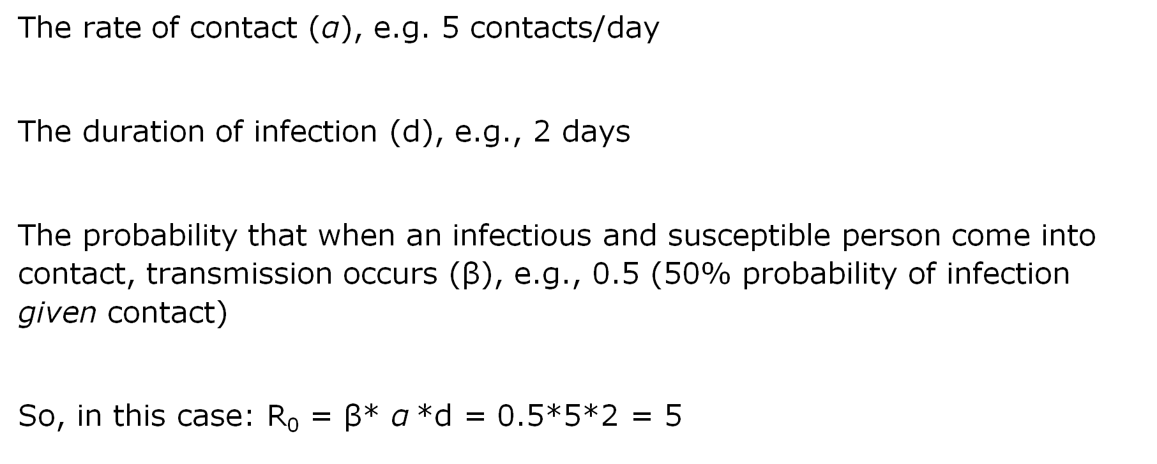
Basic reproduction number, R₀ , from component parts
The rate of contact ($\text{α}$), e.g. 5 contacts/day
The duration of infection (d), e.g., 2 days
The probability that when an infectious and susceptible person come into contact, transmission occurs (β), e.g., 0.5 (50% probability of infection given contact)
So, in this case: R₀ = β* $\text{α}$*d = 0.5*5*2 = 5

Slide 18
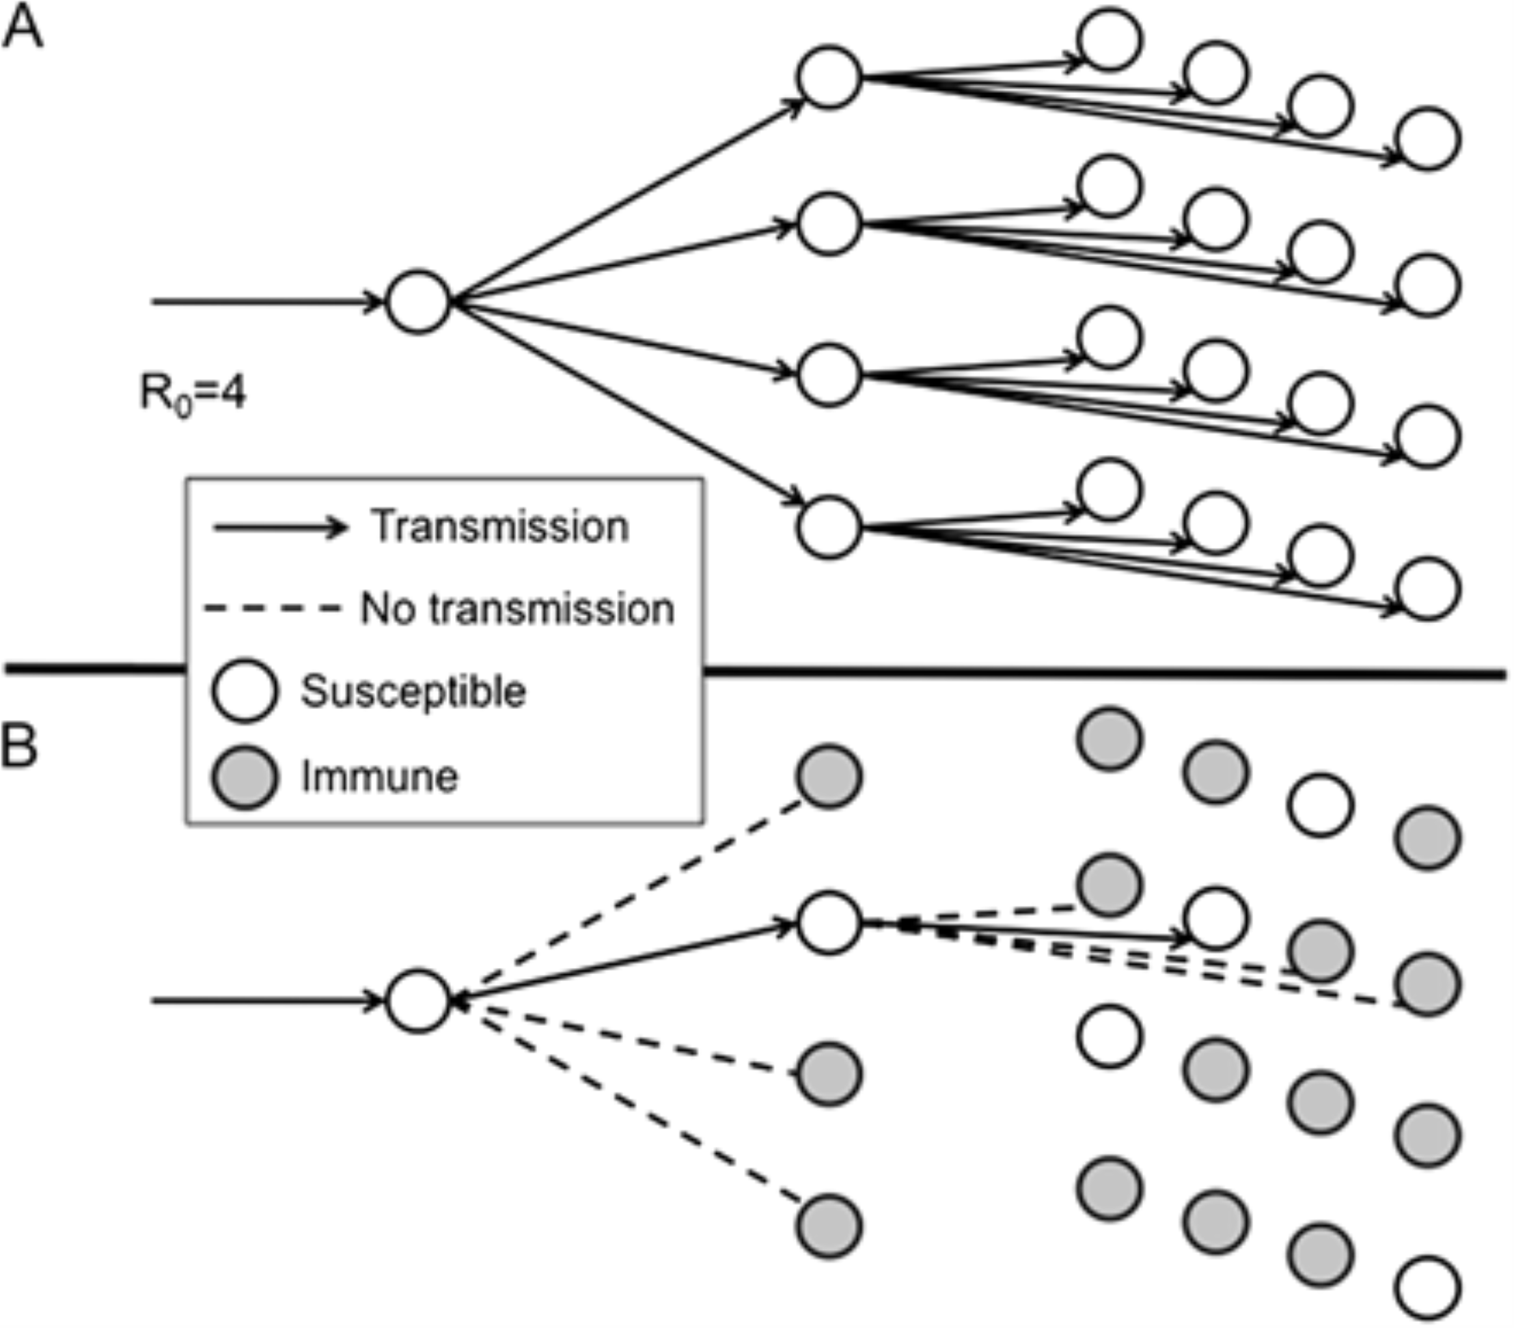
Effective reproduction number, R_{E}
Effective reproduction number, R_{E}, is the actual number of successful transmissions per infectious person
R_{E} = R₀* s
s = fraction susceptible

Slide 19
Transmission of an infection with Ro = 4, 75% protected by vaccination
Infected
Susceptible
Immune
Transmission
Notes:
Very difficult for a virus to spread in a population that’s highly protected – we have a different metric for this!

Slide 20
Herd immunity threshold (HIT)
The proportion of the population that must be immune for an epidemic to start slowing down
How to be ‘immune’ – vaccination or previous infection (if infection confers immunity)
HIT = 1–1/R₀
The larger R₀, the higher the herd immunity threshold
e.g., If R₀ = 10, HIT = .90

Slide 21
Questions?

